Slide 1
Neural collaborative filtering – hands on!
Guy Shtar
Shtar (at) bgu.ac.il

Slide 2
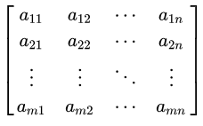
Motivation
1. Item
1. Movie
2. Word
3. Feature
Recommender systems
IMDB, eBay, Netflix, news etc.
Information retrieval
Search engines (you know…)
Dimensionality reduction – many fields
Curse of dimensionality
Mainly when data is sparse
1. User
2. Document
3. Instance

Slide 3
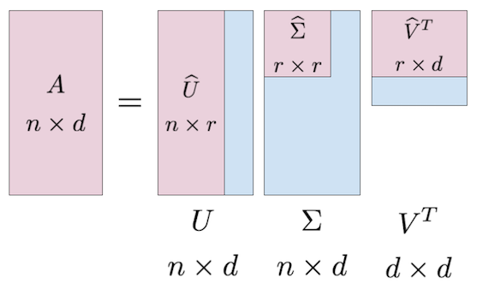
Dimensionality reduction
Well known methods:
Singular value decomposition (SVD)
Principal Component analysis (PCA)
Very similar concepts
Linear

Slide 4
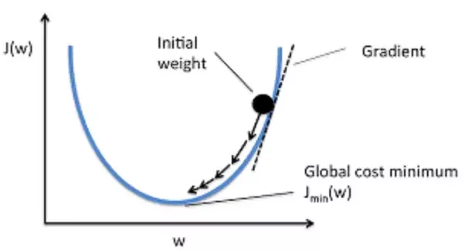
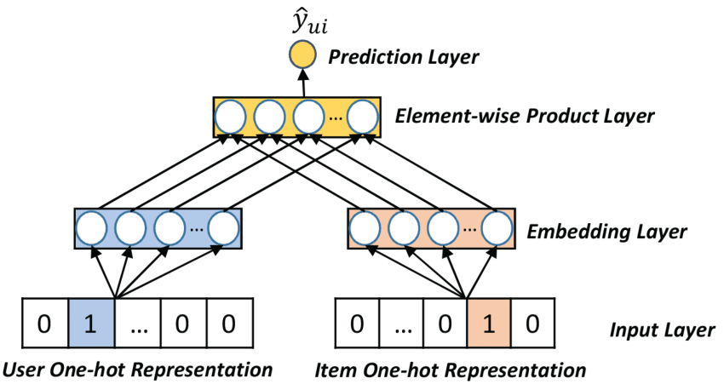
We are here for Neural Networks!
(cell value)
Merge (concatenation\Multiply etc.)
Optimizing
Lower dimension
(Row)
(Col)

Slide 5
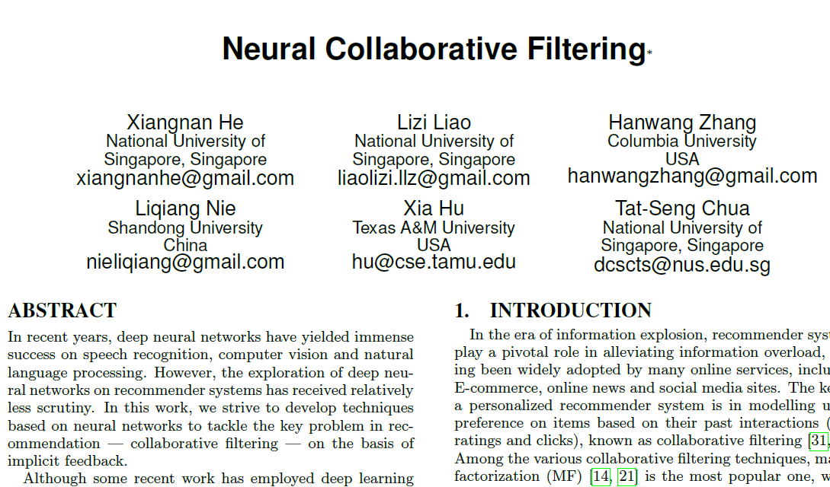
Theoretical basis for today
Xiangnan He, Lizi Liao, Hanwang Zhang, Liqiang Nie, Xia Hu and Tat-Seng Chua (2017). Neural Collaborative Filtering. In Proceedings of WWW '17, Perth, Australia, April 03-07, 2017.
Three collaborative filtering models: Generalized Matrix Factorization (GMF), Multi-Layer Perceptron (MLP), and Neural Matrix Factorization (NeuMF). To target the models for implicit feedback and ranking task, we optimize them using log loss with negative sampling.
Author: Dr. Xiangnan He (http://www.comp.nus.edu.sg/~xiangnan/)

Slide 6
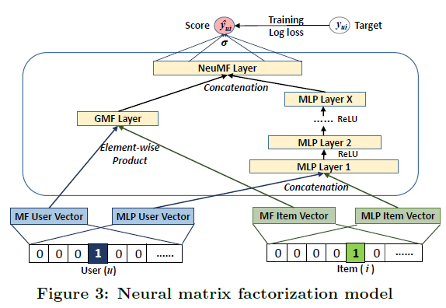
What we are going to code today
SVD like linear transformation
Non-linear transformation
Two embedding sets per dimension.

Slide 7
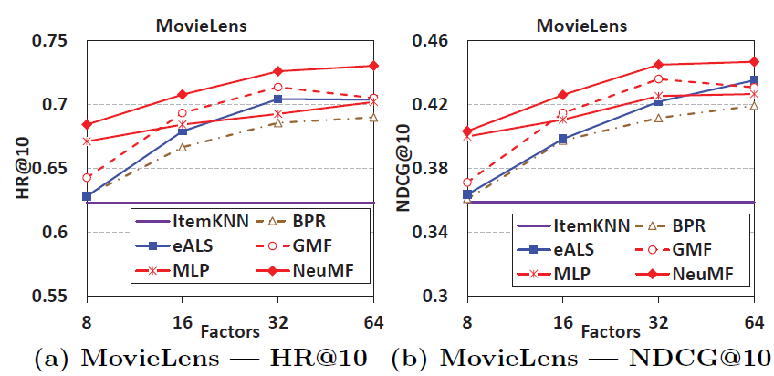
Expected results – MovieLens

Slide 8
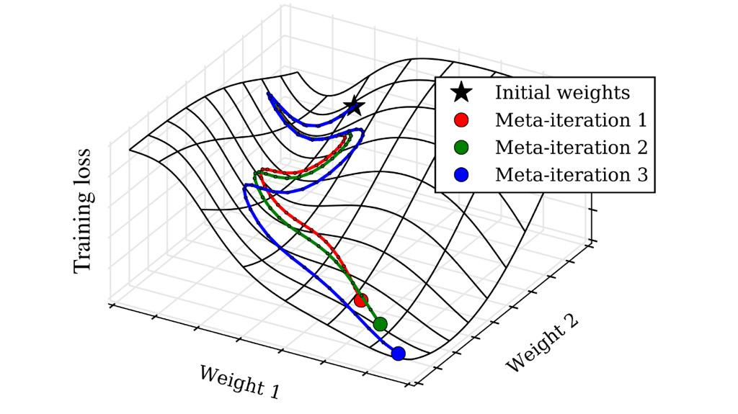
Other concerns (or hyperparams)
Size of embedding
Sampling
Number of layers, size of layers
Regularization
Dropouts
L2
Batch size, learning rate, early stopping, Loss function
Initializers, activations
“Pre training”

Slide 9
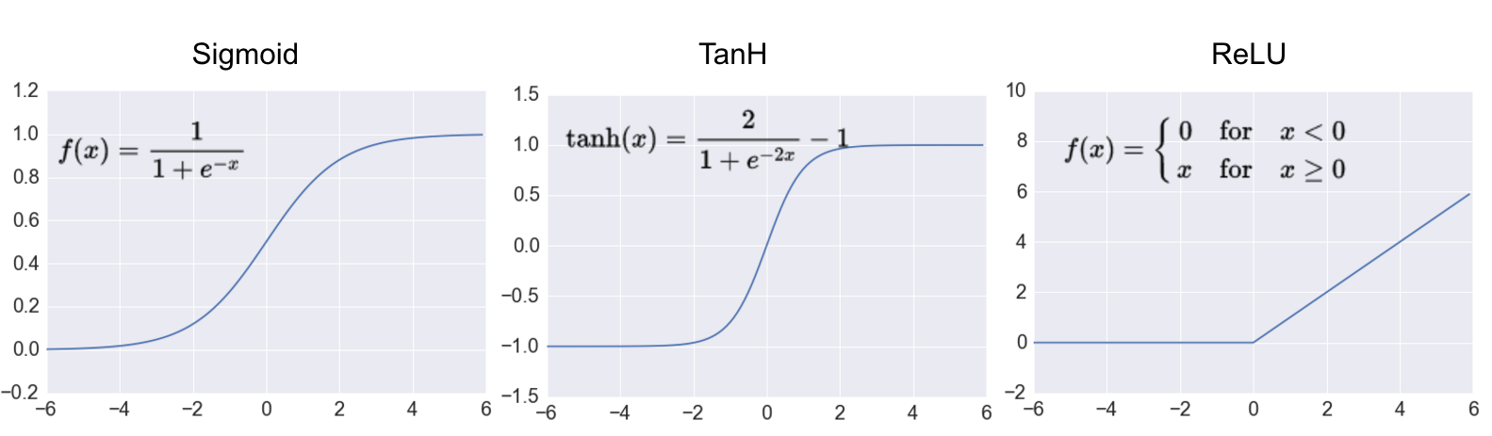
ReLU vs Sigmoid vs TanH

Slide 10
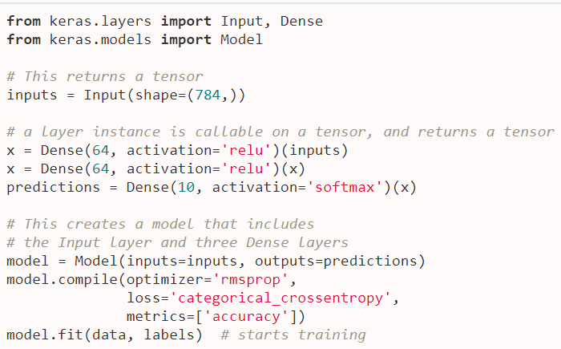
Functional API

Slide 11

Hands on time

Slide 12
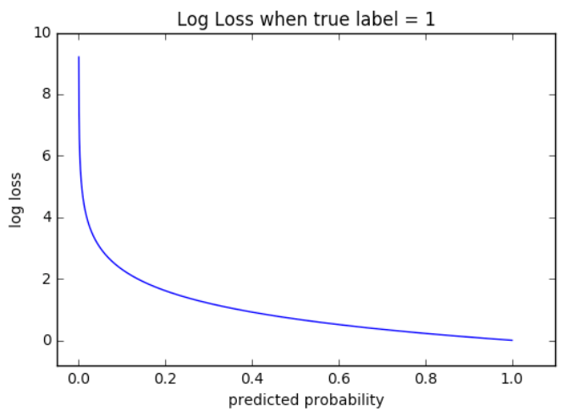
Loss
The paper uses binary_crossentropy

Slide 13
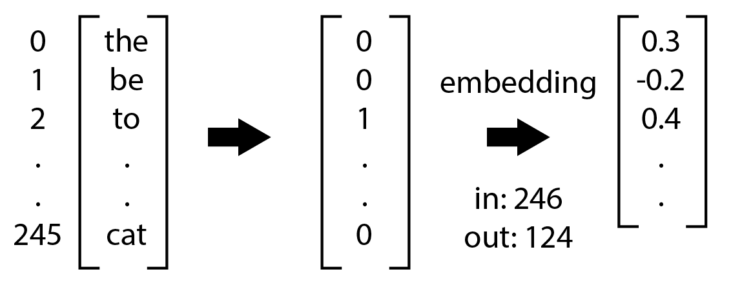
Embedding layers
keras.layers.Embedding
input_dim: number of object @ input
output_dim: size of embedding (size of new feature space)
Item

Slide 14

Multiply
keras.layers.Multiply()

Slide 15
Dense
keras.layers.Dense
Units: size of output space
Activation: activation function (tanh, relu, activation, linear etc.)

Slide 16
Input and outputs
model = Model(inputs=[input1,input2… inputN], outputs=[output1, output2… outputN])

Slide 17
Concat
keras.layers.Concatenate(axis=-1)
[1,2,3] concatenated with [4,5,6] = [1,2,3,4,5,6]

